Slide 1
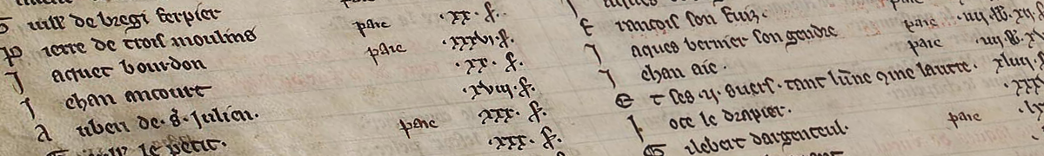
The TAX Rolls of Medieval Paris
https://github.com/nadaniels/taxrolls
Nathan A. Daniels
Johns Hopkins University
@nathanadaniels

Slide 2
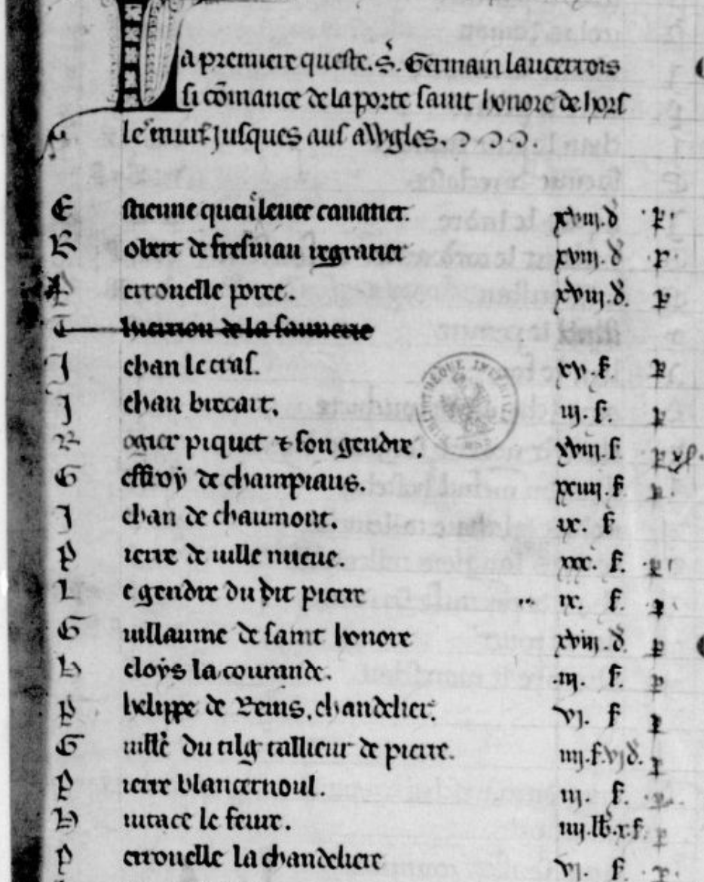
Manuscript Data
People
Names
Given, Occupational, Toponym, ??
Occupations
Taxes Owed and Paid
Familial Relationships, Household Organization
Topography
Bureaucratic Organization
Population Density
Income Distribution

Slide 3
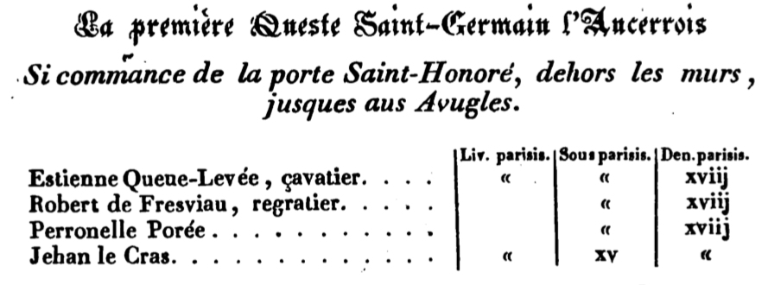
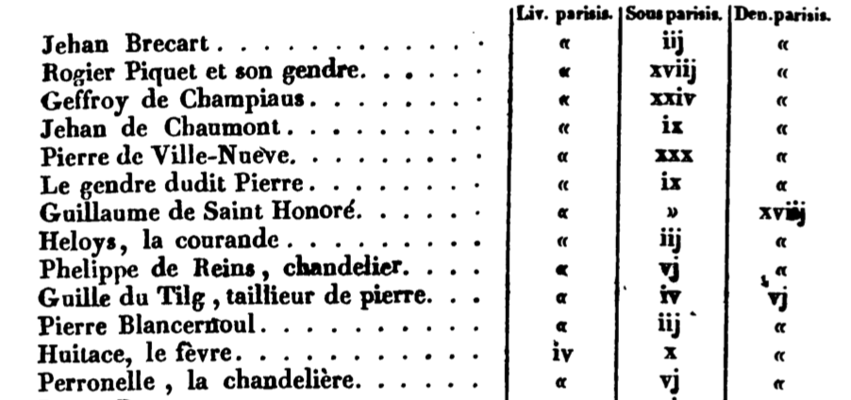
Manuscript vs Published

Slide 4
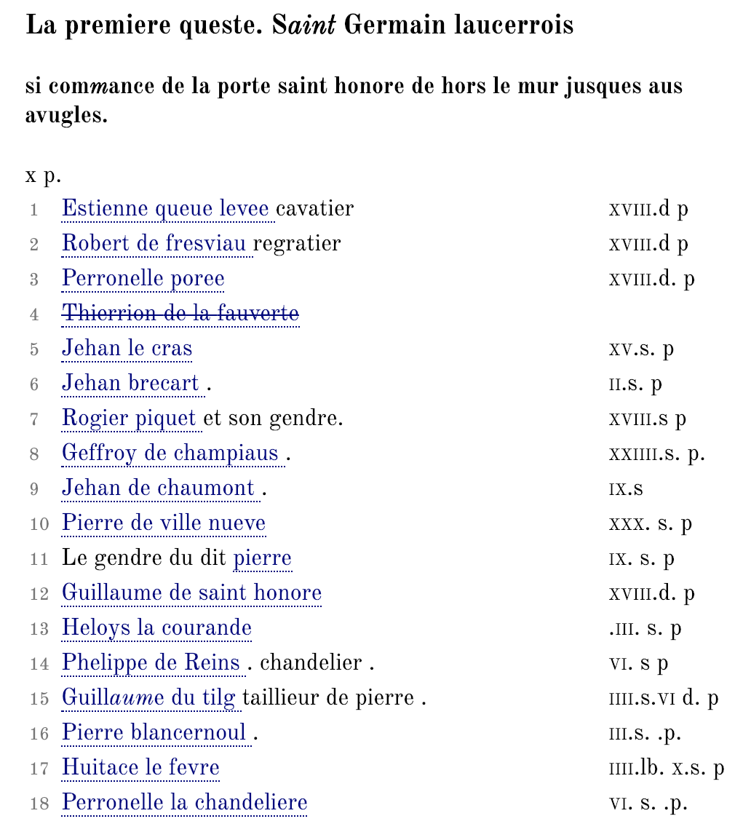
Manuscript vs Digital Edition

Slide 5
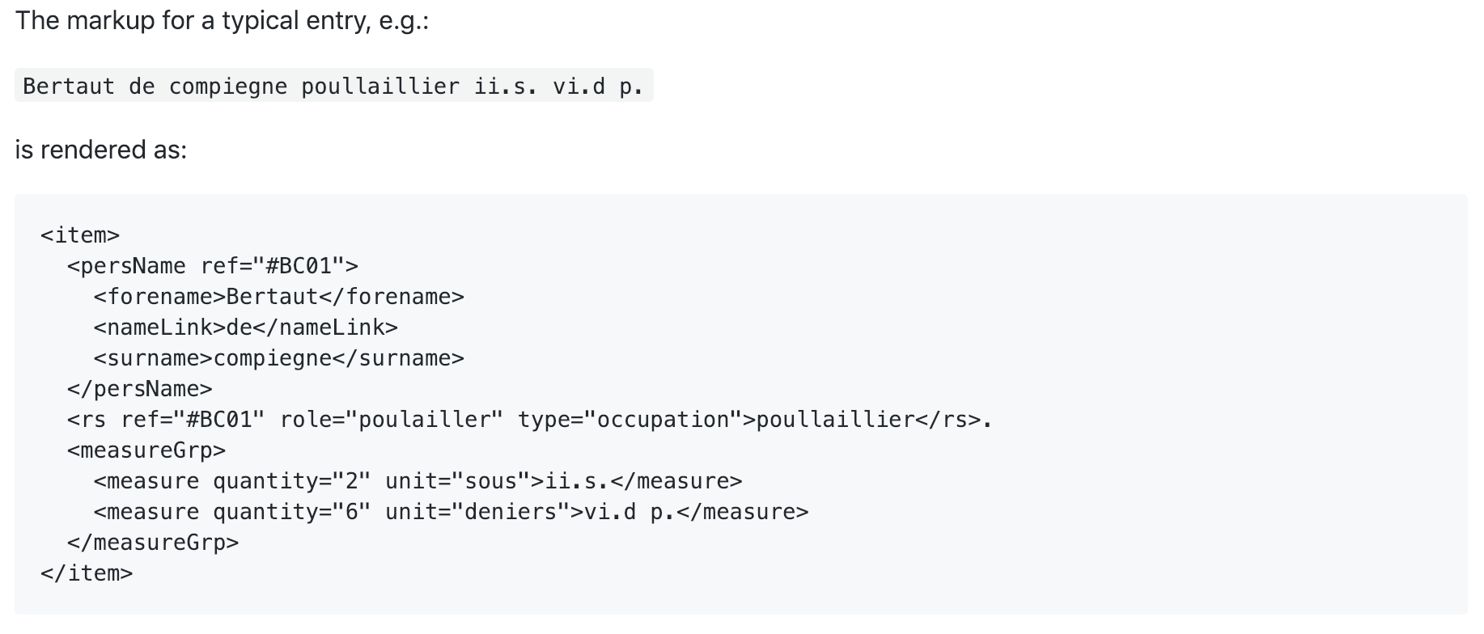
Sample TEI Markup

Slide 6
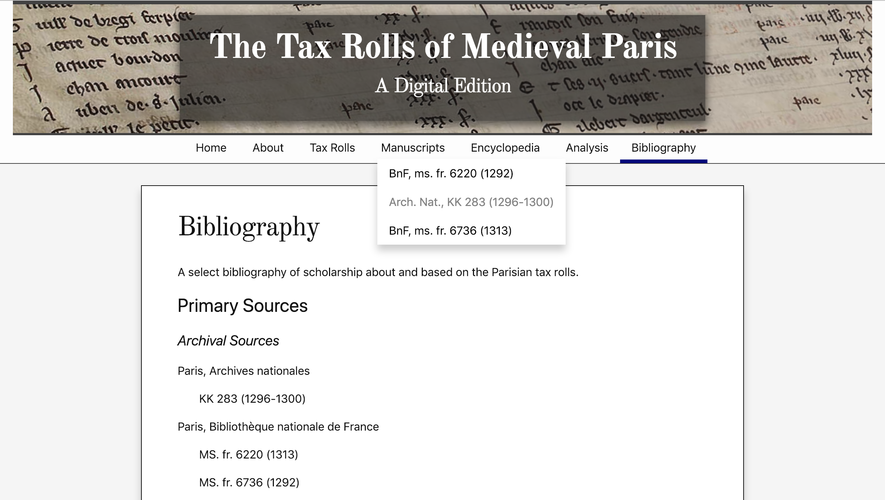
Prototype Website

